Slide 1

Parallelisation
Of scenario
Azure Machine Learning

Slide 2

Before I begin
aml == azure machine learning
I really really really prefer to define the components and pipelines using yaml and running via the az cli.
It looks like parts of what I am showing are still in preview and I belive Microsoft is en-route to add and improve
Microsoft has really good examples and tutorials some very well hidden

Slide 3
What is beeing parallelised?
Data -> Spark / pyspark
function calls. E.g. apply same function to all elements of a list – python multiprocessing (multi-threading)
processing independent modules (components) in a pipeline
Each AML component is a container – independent containers can be run in parallel
component type Parallel – applies a module to subsets of a data set of files in folders (nodes and cores)
Advanced
Near Real time – heavy duty – Azure Kubernetes Services (ASK)
Sophisticated – RAI & DASK – advanced used of nodes, cores and threds through defining a DAG of processes.

Slide 4
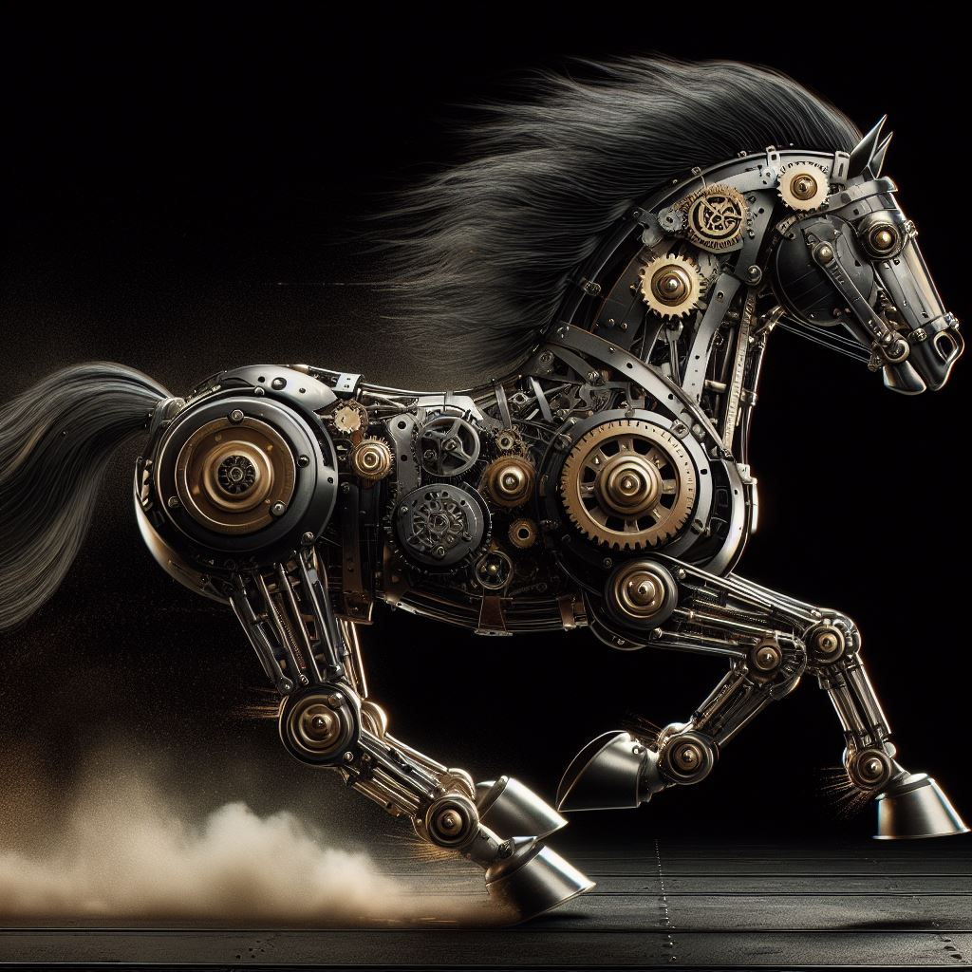
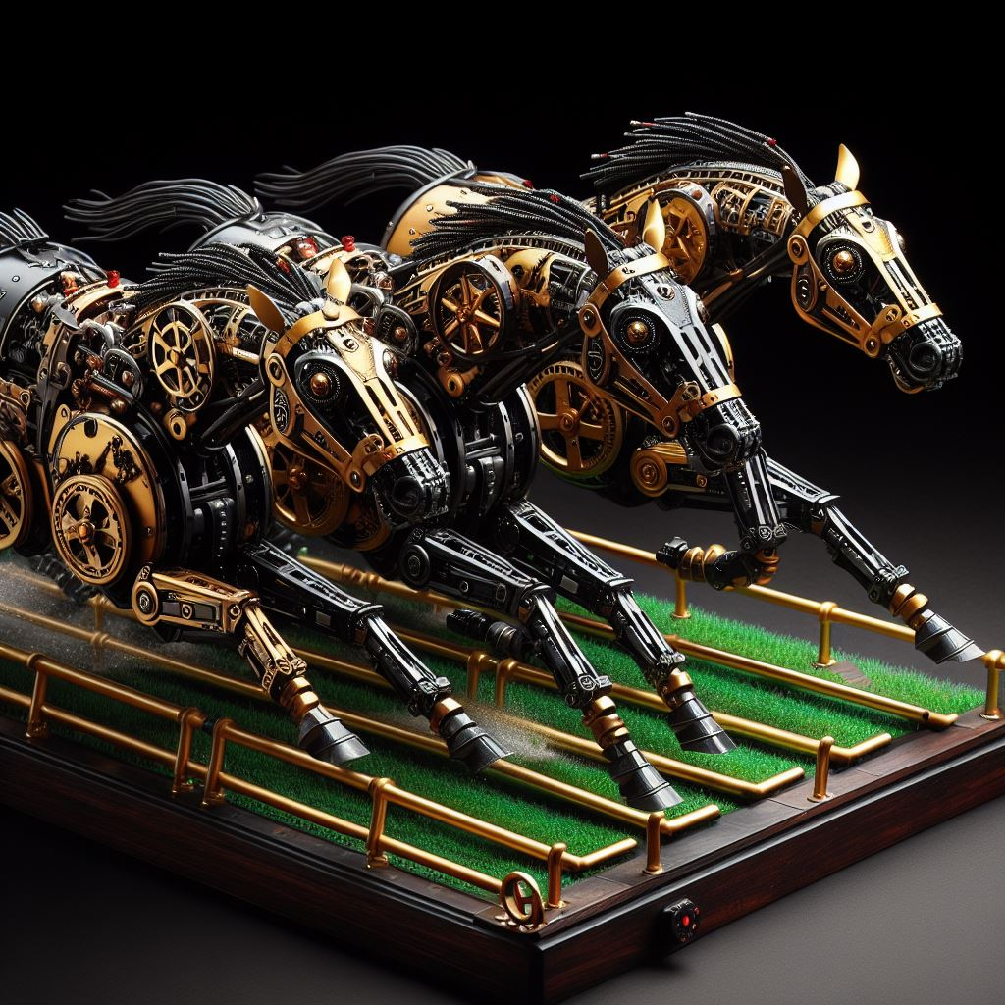
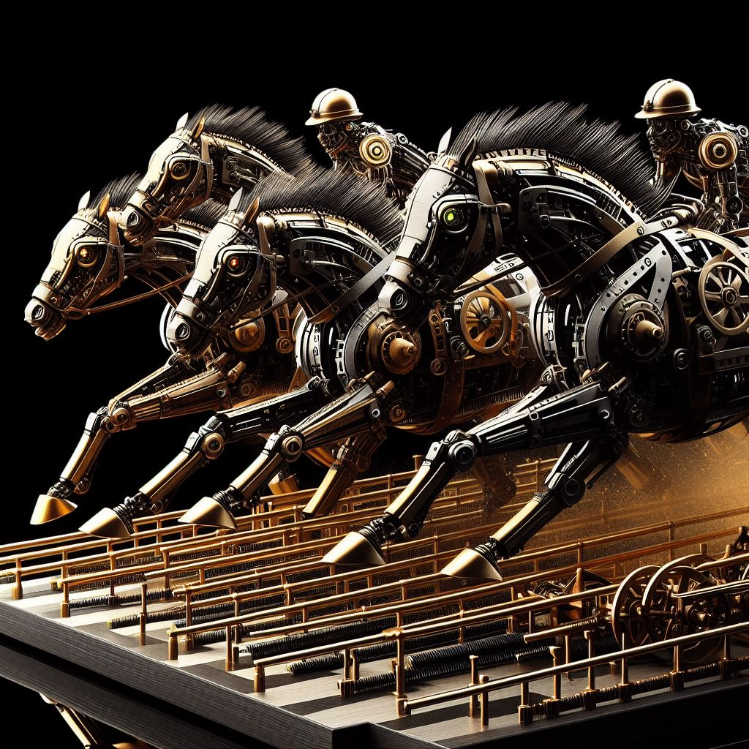
Bird Model: SIR type model of bird population development
Hautphenne, S., and Patch, B., (2021). Birth-and-death Processes in Python: The BirDePy Package. arXiv preprint arXiv:2110.05067
Just run an aml pipeline several times with different scenario setting
Use the aml Parallel component

Slide 5

It looks complicated until someone demonstrates how it is done

Slide 6
**First login to the az facility**
```bash
az login --identity
az account set --subscription “<your subscription>"
export AZURE_ML_CLI_PRIVATE_FEATURES_ENABLED=true
```
**running one job**
```bash
# cd to where your pipline yaml is
az ml job create --file one_bird_model_pipeline.yaml
```

